Slide 1
Ataraxia
Concept Video

Slide 2
Value Proposition: Learn to be a happier you
Problem
People aren’t aware of what they can be doing to take care of themselves - what makes them happier and what doesn’t.
Solution
Ataraxia will guide people through the process of learning what works for them and what doesn’t when it comes to taking care of themselves.

Slide 3
Tasks
Simple: Discover a new self-care method
Medium: Record how a method of self-care makes you feel
Complex: Develop a self-care routine

Slide 4
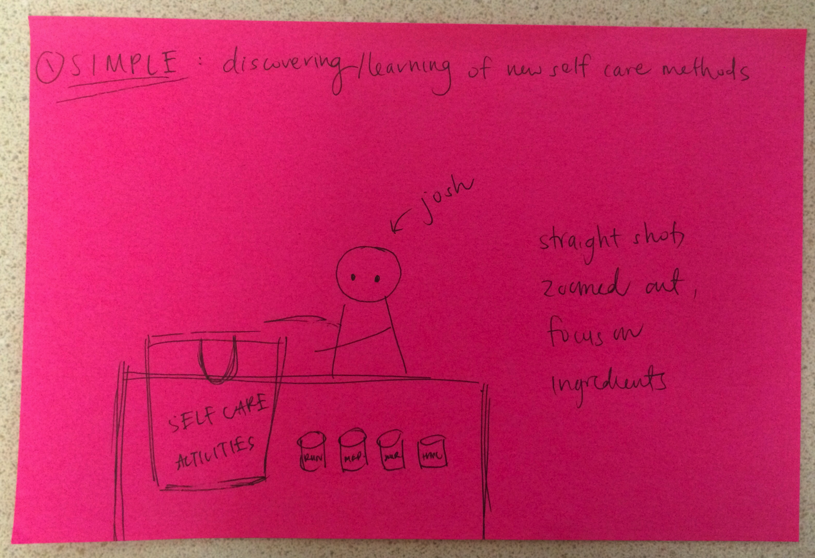
Storyboard - Simple #1

Slide 5
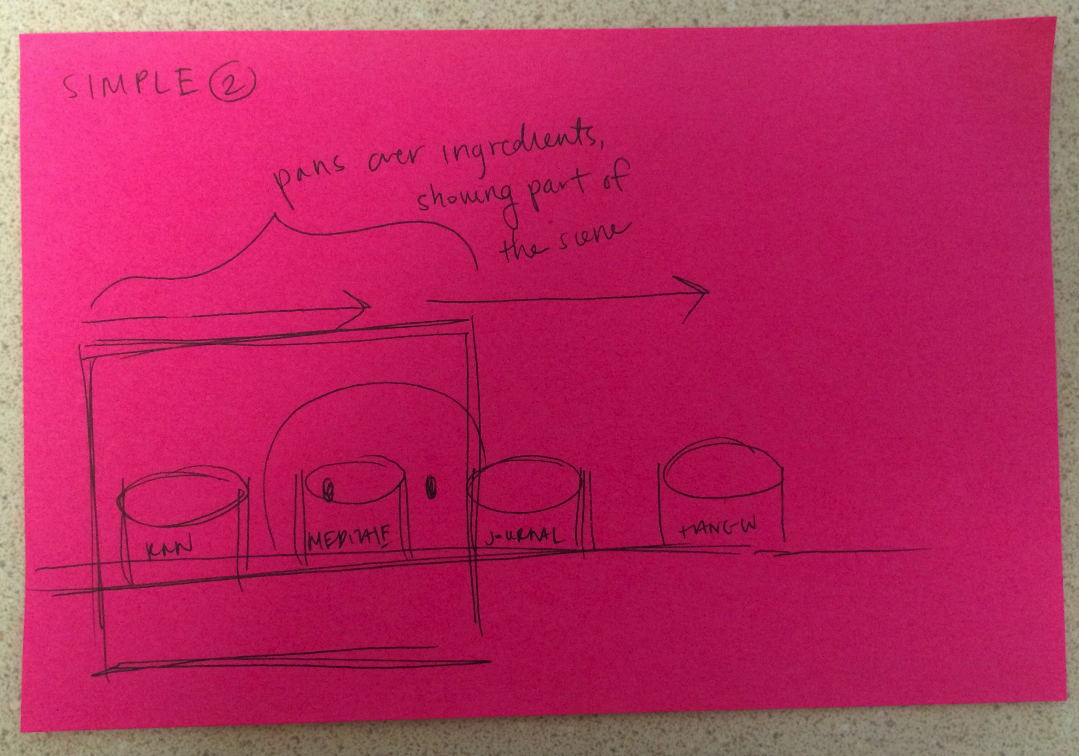
Storyboard - Simple #2

Slide 6
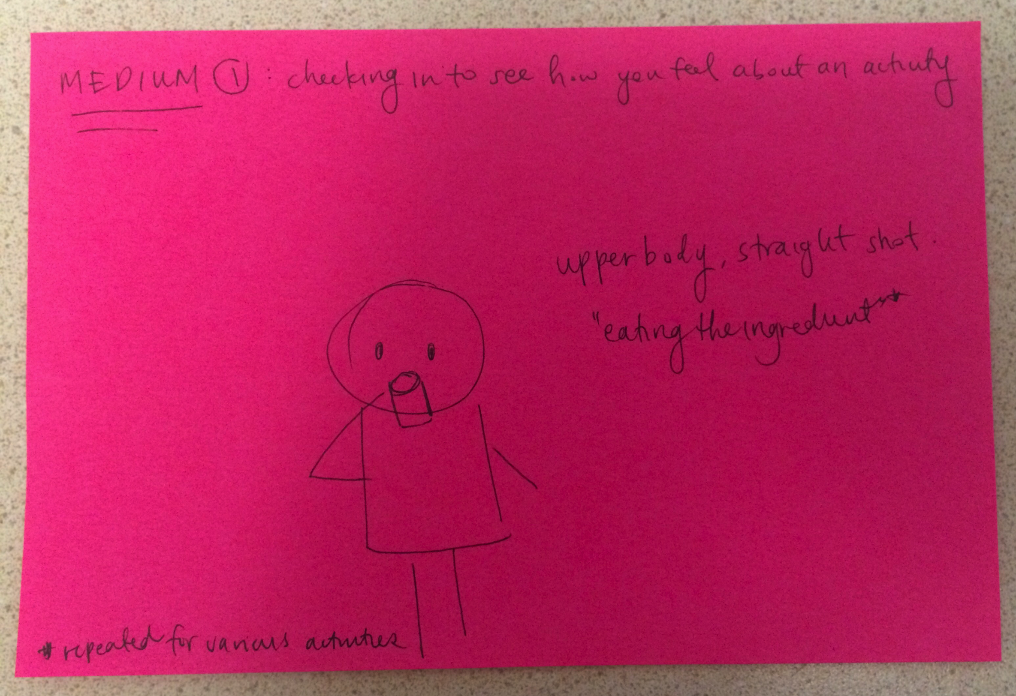
Storyboard - Medium #1

Slide 7
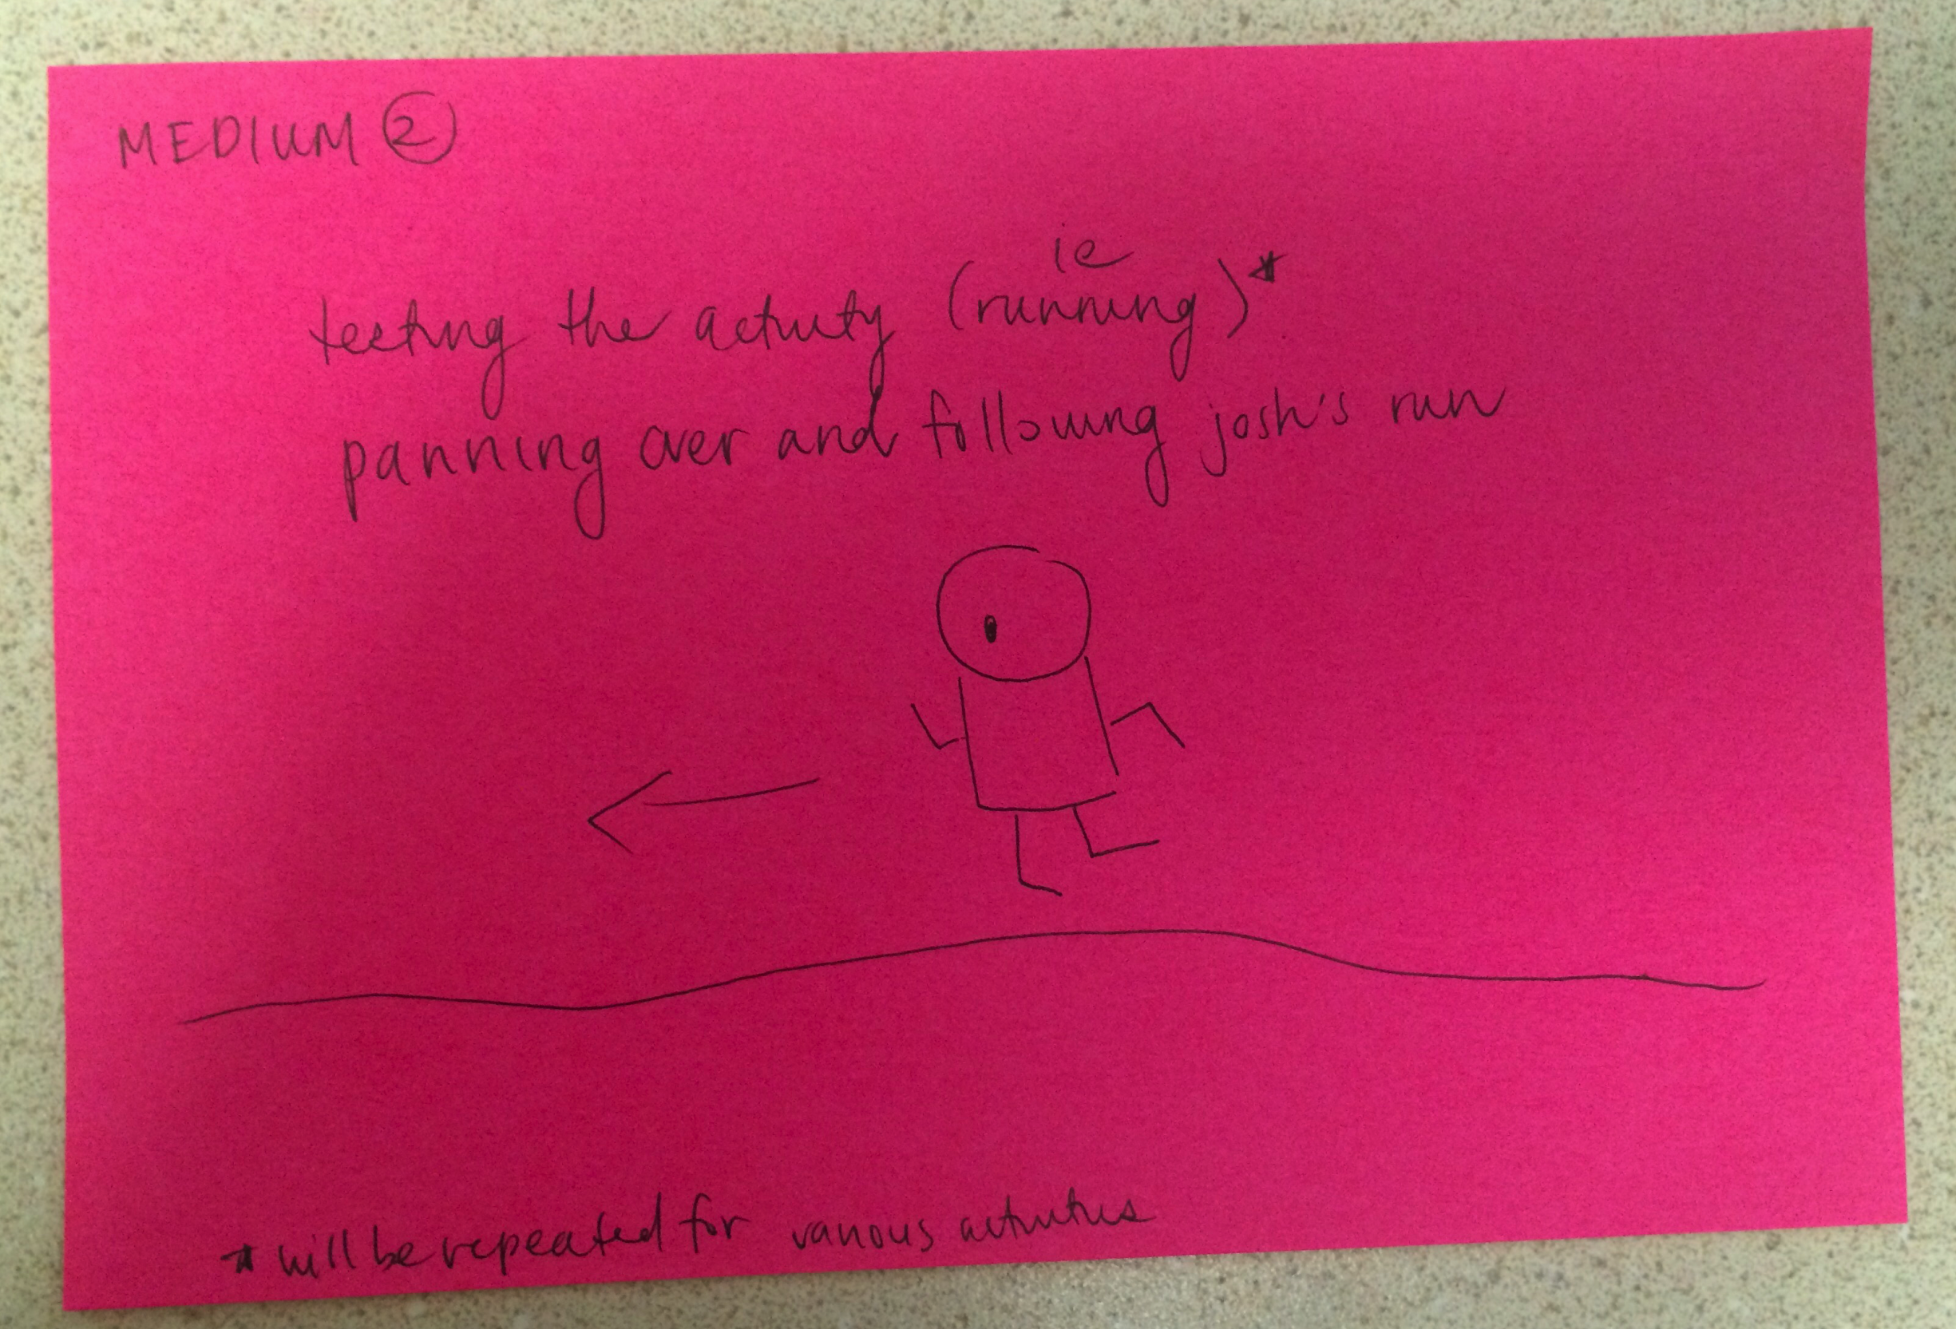
Storyboard - Medium #2

Slide 8
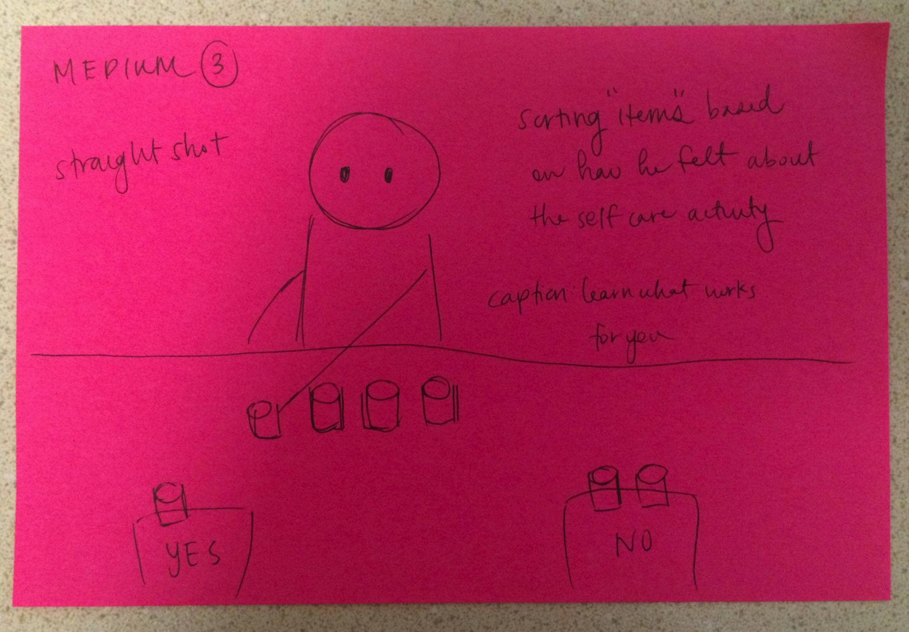
Storyboard - Medium #3

Slide 9
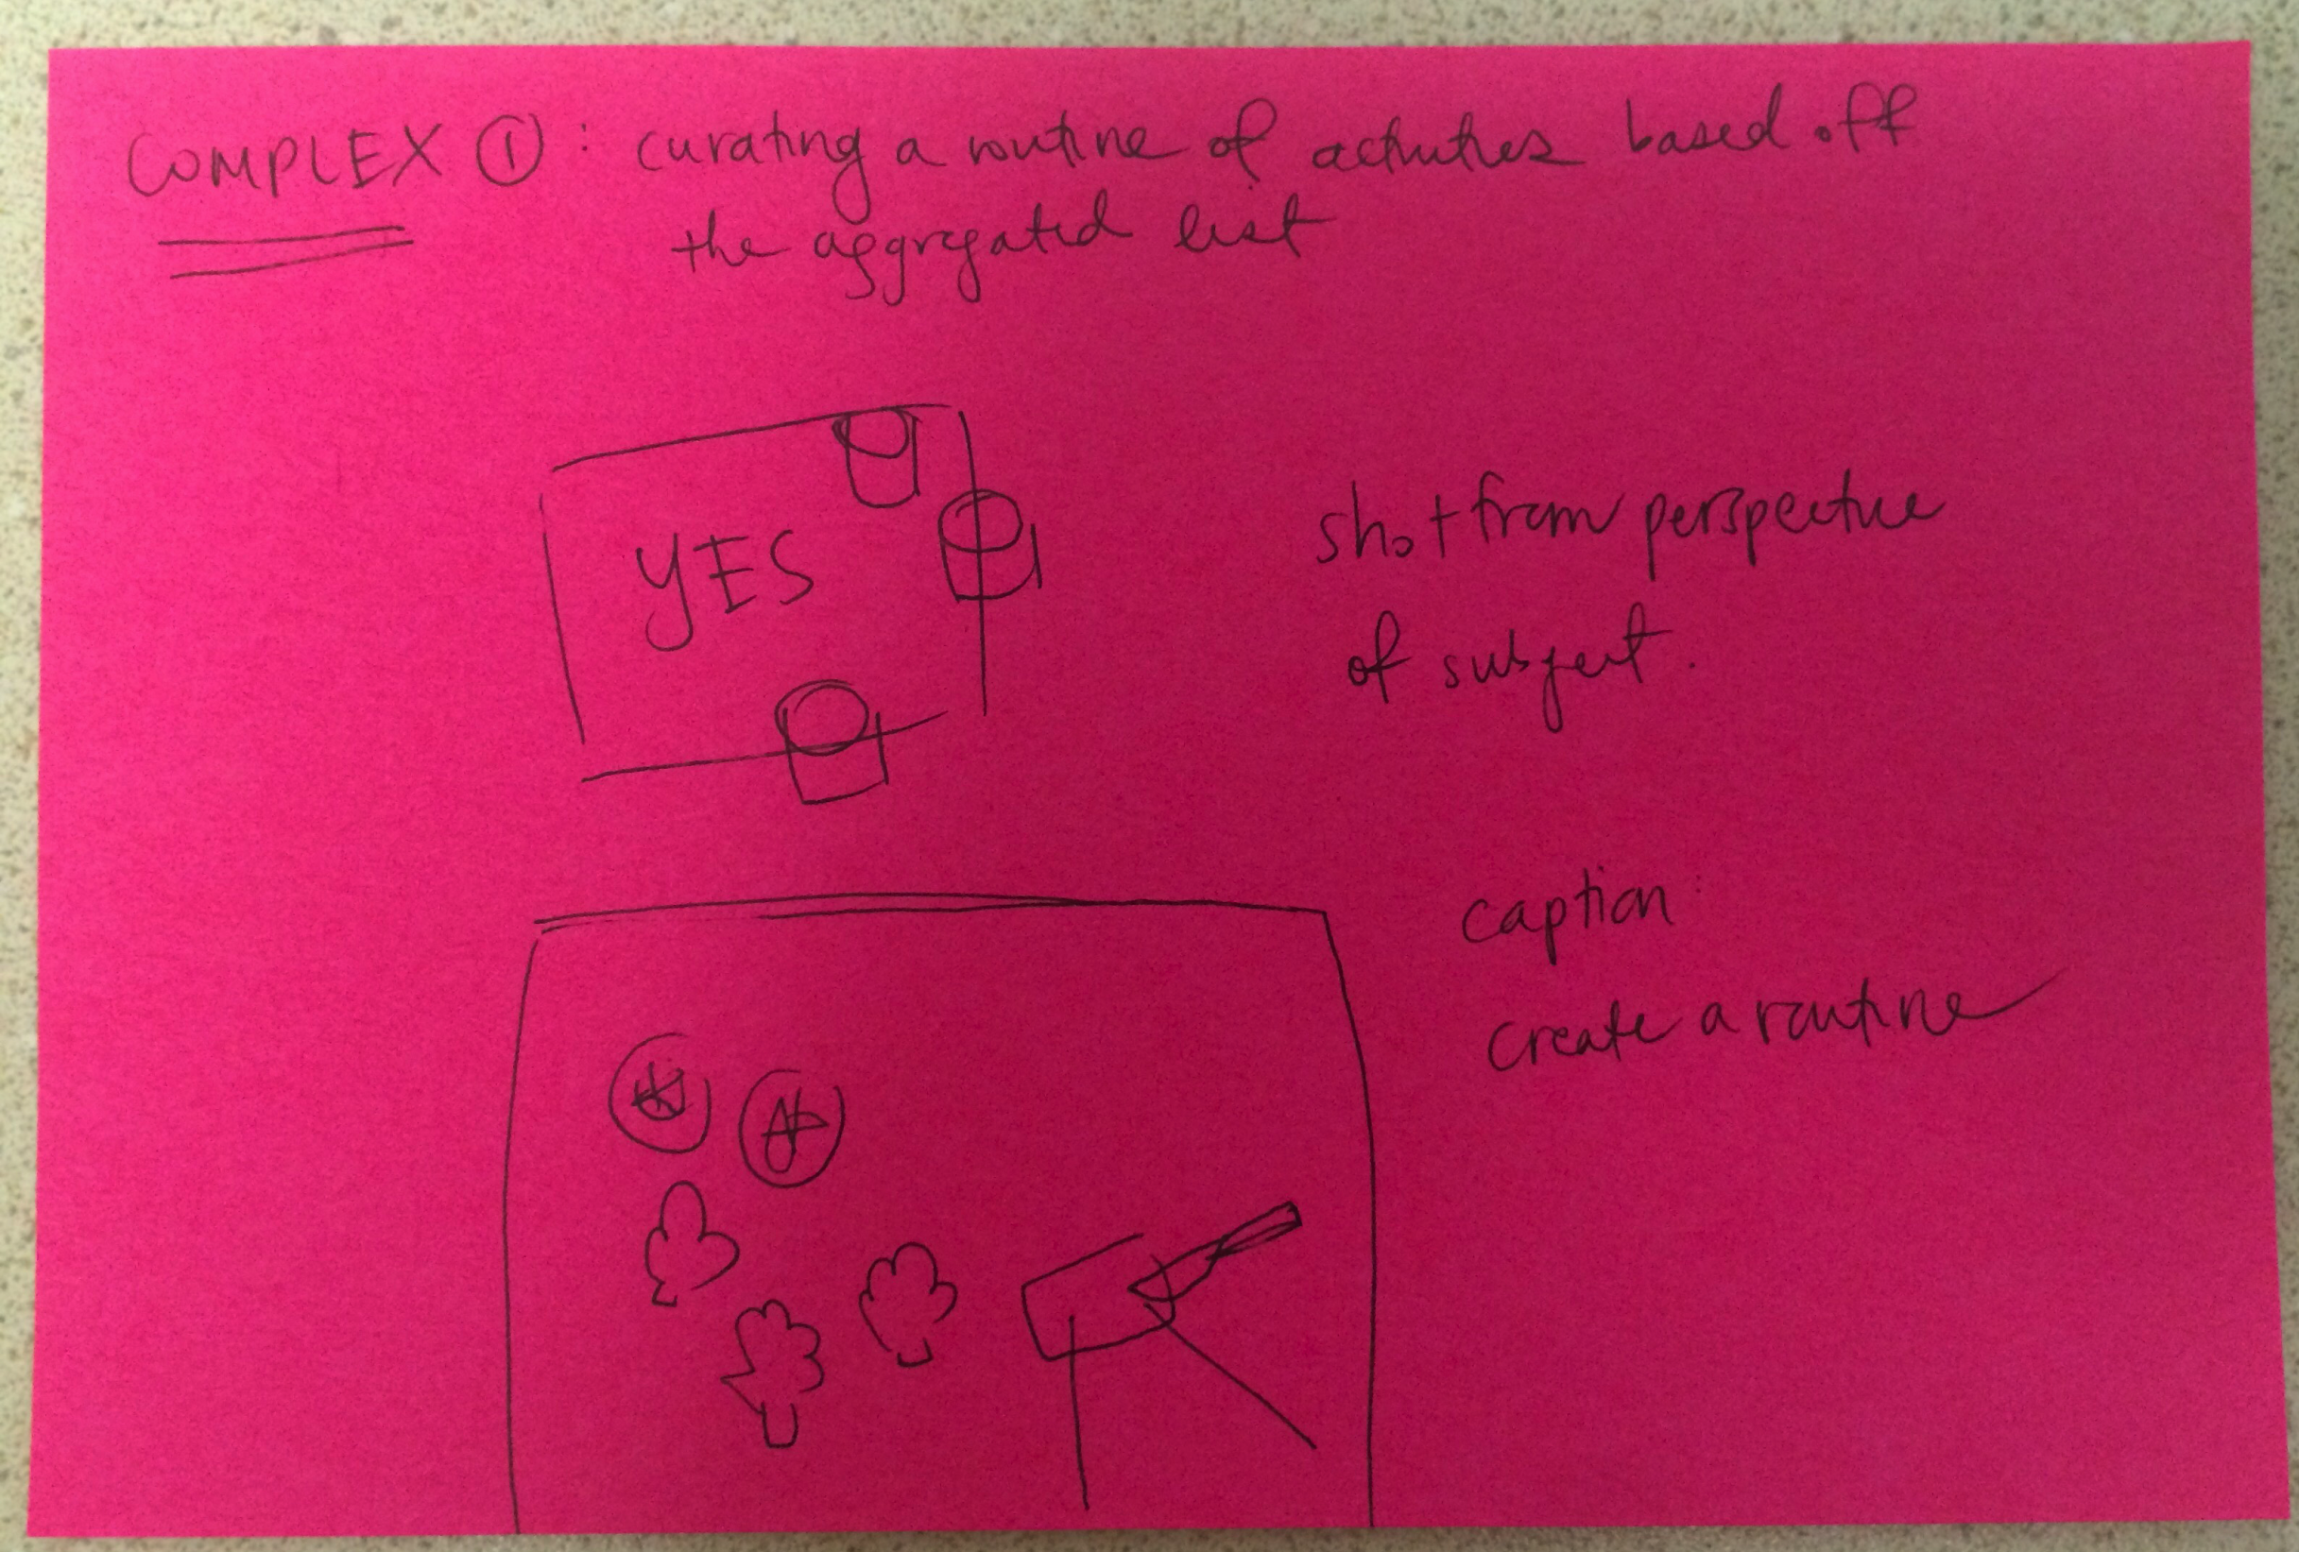
Storyboard - Complex #1

Slide 10
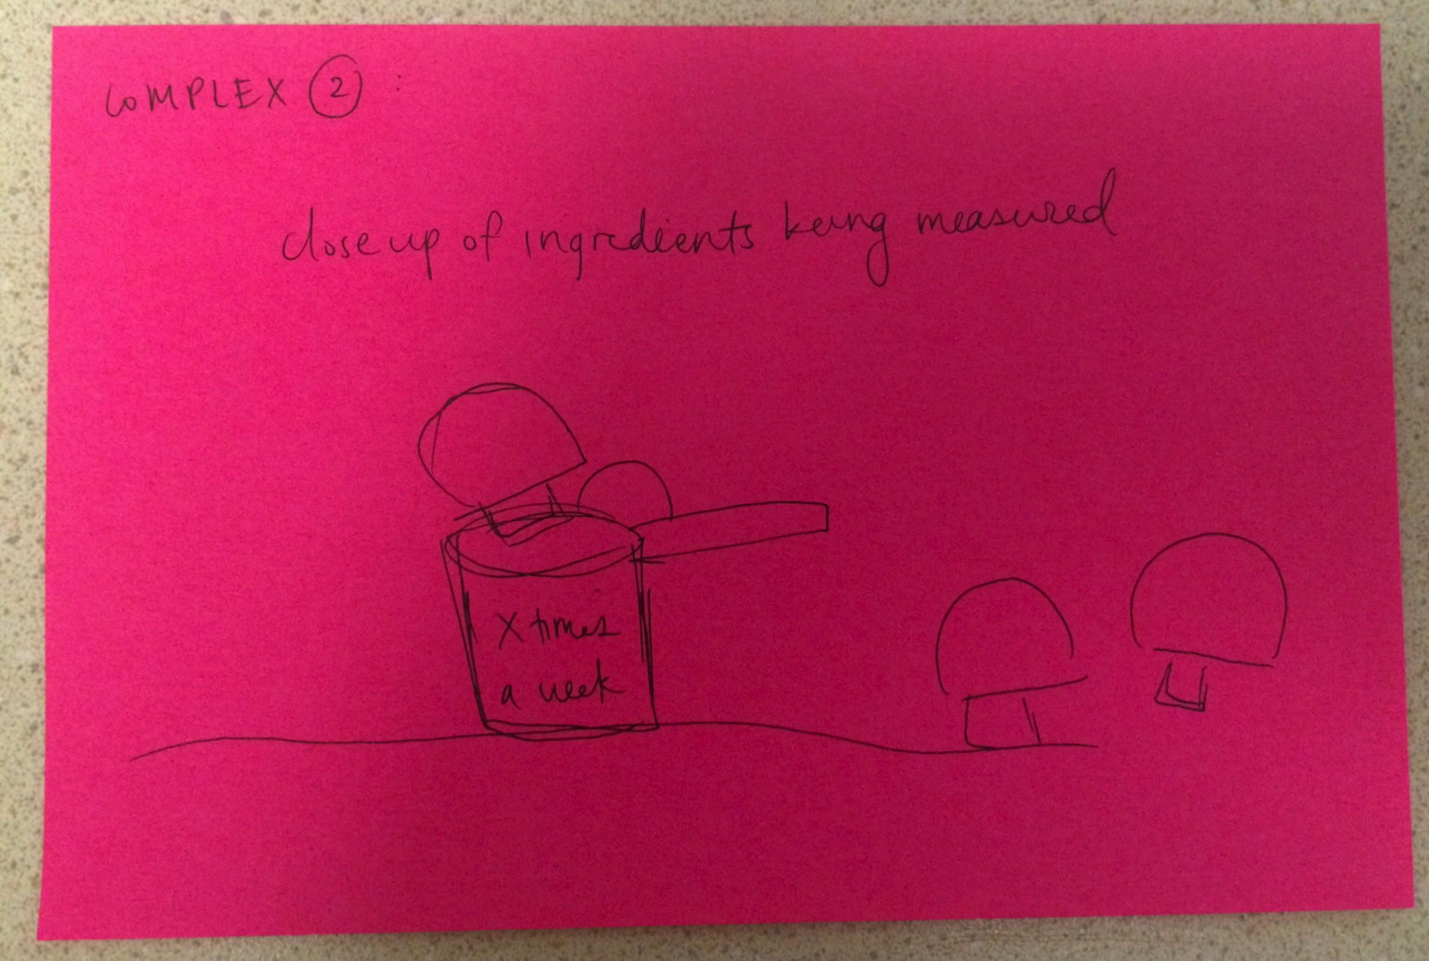
Storyboard - Complex #2

Slide 11
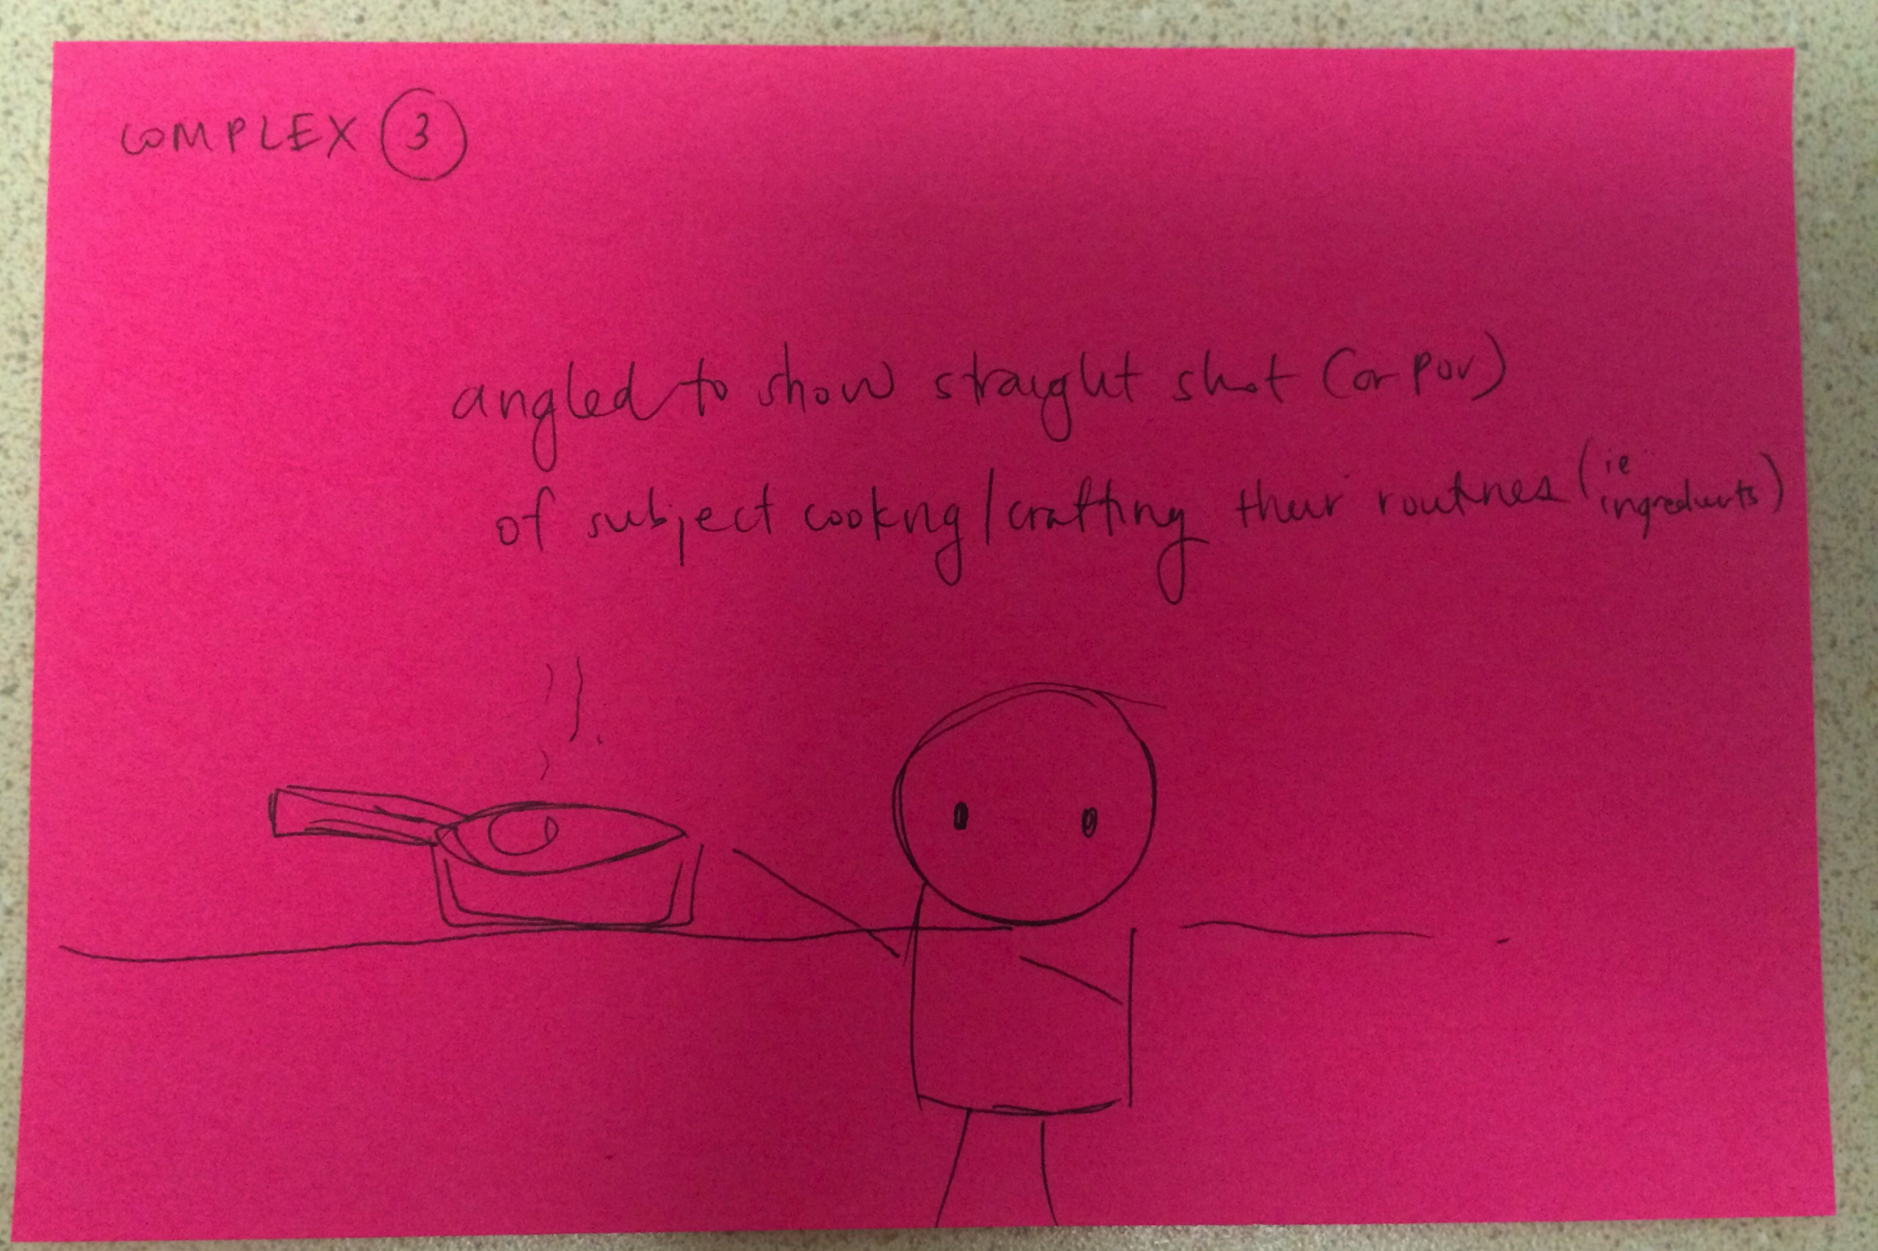
Storyboard - Complex #3

Slide 12
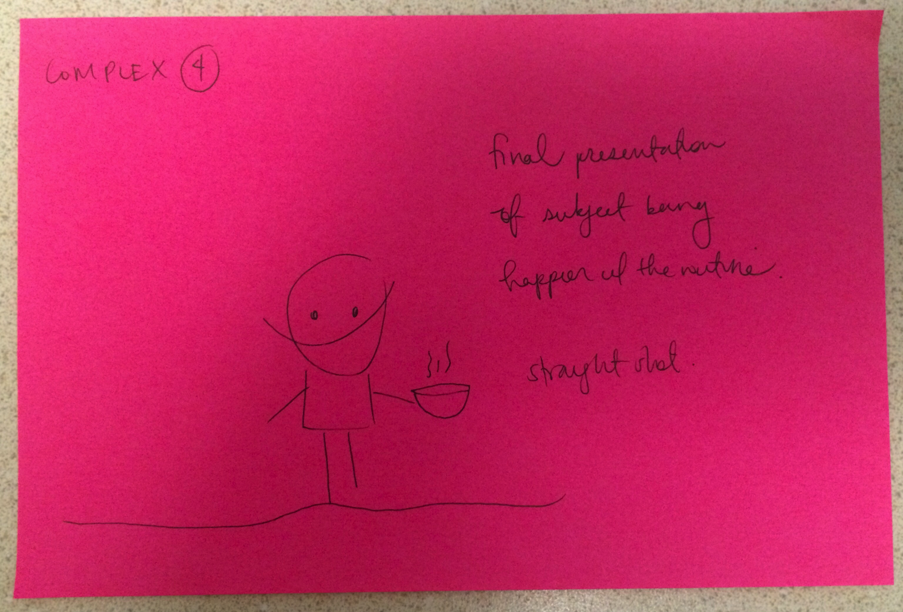
Storyboard - Complex #4

Slide 13
Video
https://tinyurl.com/cs147-ataraxia
Notes:
vimeo.com/239067257

Slide 14
QUESTIONS?

